Slide 1
Academic Internationalization in the 21st Century:
Comprehensive, Engaged, Collaborative
Susan Buck Sutton
Senior Advisor for International Initiatives,
Bryn Mawr College
Associate Vice President for International Affairs (Emerita), Indiana University

Slide 2
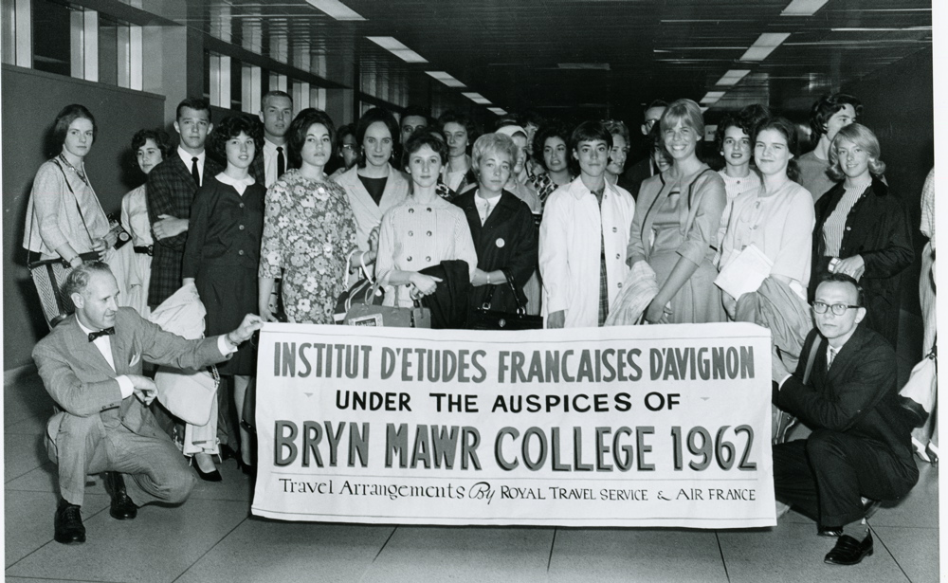
International Education in the 1960s
Bryn Mawr College
Notes:
Not so long ago, international education meant Junior Year Abroad programs

Slide 3
International Education in the 1960s
IUPUI

Slide 4
Historically , international education in the U.S. was seen as:
Counting students “in” and students “out”
Teaching some students another language
Relevant only to certain types of institutions, disciplines, and students
Central neither to the institution nor to student learning
A scattered set of disparate activities
Not of great interest to most faculty

Slide 5
Carnegie Foundation Survey, 1991-93
“…U.S. faculty participation in international activities and programs is … lower than that of academics in the other countries studies.
It is not misleading to describe U.S. faculty as parochial in outlook and behavior …”
(The International Academic Profession, 1996, p. 386)

Slide 6

The world has changed since then.

Slide 7
The ivory tower is no more.
Notes:
The era of the Ivory Tower is over.

Slide 8
The global reorganization of higher education:
greater student #s worldwide (massification)
greater student mobility across nations
use of IT to shrink distances
global nature of science, scholarship, & the professions
need to educate students for global competence
postcolonial perspectives on knowledge
spread of excellent institutions worldwide
rise of regional/global networks & rankings
greater need to generate income from tuition
rise of globally-delivered forms of higher education
increasing awareness of global nature of many problems
globalized nature of communities we serve
Notes:
This is the world in which our institutions now operate, and we must reshape them for it.
A reorganization in which campus walls, both ivy-covered and red-brick, are disintegrating.
It is hard for us to think beyond the boundaries and the terminology that characterized a less interdependent system of higher education.
But we must do so.

Slide 9
A new word was needed.
INTERNATIONALIZATION
“integrating an international and intercultural dimension into the teaching, research and service functions of an institution” (Knight 1994)
“integrating an international perspective … to respond and adapt to an increasingly diverse, globally focused, ever-changing external environment “ (Ellingboe, 1998)
“the wise, informed, and responsible engagement of students, faculty, staff, and the institution itself in the global networks that shape us all” (IUPUI 2008)

Slide 10
ACE Mapping Survey 2012
Univs. Colleges
Mission refers to IZN or IE 54% 42%
IE one of top 5 priorities 60% 48%
Has separate IZN Plan 55% 28%
Curr. IZN initiatives under way 90% 67%
Recently increased funding for IZN 63% 51%

Slide 11
An exciting, exhilarating, confusing, conflicting moment.
Notes:
The sands are shifting, the sea is changing
we are straining to understand what is happening, and to recast our activities accordingly
Very quickly, IZN moved from side activity to central one
New players entered the discussions on campus
New goals were put forth – some at odds with long-standing ones
Institutions recast their missions to include global impact and positioning
Recruiting of international students reached new levels
Governments came to recognize the importance of IZN for public diplomacy

Slide 12
Daunting Challenges:
Conflicting goals
Outdated structures and processes
Funding new initiatives in times of fiscal constraint
Fear of displacing other important initiatives
Fear of ignoring the local, masking local diversity tensions
Too much talk, not enough attention to carry-through
Headlong rush into international work with insufficient knowledge
Issues of health and safety that have emerged with greater mobility
Resource differentials between the global North and South
Brain drain – of students, educated population, faculty
One-sided exchanges, poorly planned branch campuses, cultural imperialism
Monolithic ranking systems that widen gulf between “elite” institutions and others
Difficulty in reaching common ground on requirements, pedagogies, across nations
Notes:
To name a few

Slide 13
Some recent headlines:
Internationalize or Risk Irrelevancy
Internationalized Academe is Inevitable
Higher Education in Turmoil
IZN of Higher Ed: Who benefits, who is at risk?
IZN of Higher Ed: The good, the bad and the ugly
Notes:
Challenges are many; but so are the opportunities to do something transformational, liberating, invigorating

Slide 14
Is IZN becoming something other than its originators intended?
“the cross-border movement of students and of higher education programs and institutions, …the growing international market for academic and scientific personnel, curricular internationalization, and the commercialization of international higher education, especially the growing influence of the for-profit higher education sector” (Altbach 2013)
“now becoming a catch all phrase used to describe anything and everything linked to worldwide, intercultural, global, or international and… at risk of losing its meaning and direction” (Knight 2012)

Slide 15
Not if we take the time to do it right.

Slide 16
Invigorating opportunities:
using IT to overcome geography, reduce costs, teach collaboratively
exploring the international dimensions of all disciplines
expanding international experiences to a broader group of students
creating internationally diverse student bodies and faculties
opening up issues of global citizenship and action, for our students and our institutions

Slide 17
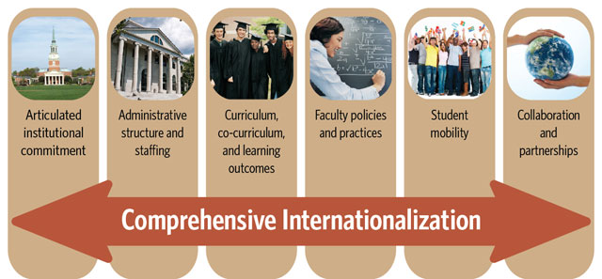
1. Approach IZN as institutionally comprehensive

Slide 18
2. Approach IZN as internationally collaborative.
Collaborative IZN = “constructing forums through which we bring different international perspectives into genuine and serious dialogue, rise above ourselves, better understand the world as a whole, and collaborate for mutual transformation.”
(Sutton 2013)

Slide 19
Transactional Transformative
Notes:
This continuum identifies an important dimension of partnerships.
Borrowing from the literature on service learning (Enos and Morton 2002) .
Institutions need partnerships of both types for they serve different purposes.
But for maximum institutional impact, and for forming new kinds of global academic linkages, transformative partnerships are best.

Slide 20
3.IZN thrives on active engagement.
Engagement = the act of engaging
(participating, being a part of, taking action, making a commitment to)
(Merriam-Webster on-line dictionary)

Slide 21
4.IZN thrives on knowledge of best practices.
Resources for Campus Internationalization
The common portal of the Inter-Association Network on Campus Internationalization (INCI).
http://campusinternationalization.org/

Slide 22
5.IZN thrives by connecting the local and the global.

Slide 23
6.IZN asks for institutional global citizenship.
Affirming Academic Values in Internationalization of Higher Education: A Call for Action, 2012
International Association of Universities
http://www.iau-aiu.net/sites/all/files/Affirming_Academic_Values_in_Internationalization_of_Higher_Education.pdf

Slide 24
IZN and Strategic Planning
An on-going, seldom linear process of intersecting initiatives.

Slide 25

1.Get the right people involved in planning processes viewed as legitimate.

Slide 26
2. Take stock of existing international strengths and weaknesses.
Faculty resources
Curricular resources
Study abroad options
Co-curricular resources
Partnerships and collaborations
Policies and procedures
Alumni
Students
Internal funding sources
Scope & activities of international office(s)

Slide 27

3. Set broad vision and goals that fit the institution.

Slide 28
The wide-ranging, sometimes conflicting goals of internationalization
Institutional Goals:
To advance institutional ranking, including globally
To generate tuition income
To market programs overseas
To spread the reach/impact of the institution
To diversify the student body
To improve student learning and preparation
To keep research and scholarship cutting edge
To build/enhance the institution and its programs through collaboration
To develop global citizenship for both students & institution
To tackle global issues

Slide 29
The wide-ranging, sometimes conflicting goals of internationalization
Societal Goals:
To develop a globally competitive and culturally competent workforce
To advance national diplomacy and security
To serve the international needs and interests of surrounding communities
To contribute to nation-building
To develop capacity in the global South
To address problems that are global in scope
To contribute to international understanding and peace-building
To advance science and scholarship

Slide 30
4. Develop specific strategies.
Identify actions that:
are doable (some right away, some later)
have widespread impact
build on existing strengths and programs
do not exceed funding and staffing possibilities
remove obstacles
are sustainable over time
lead to future activities
attract or generate new resources
can be assessed

Slide 31
5. Develop organizational structures, staffing, and funding for these activities.
Clarify management and organization of this work
Structure the international office appropriately
Establish university-wide coordinating body(ies)
Provide faculty development programs
Develop IT capacity for international collaboration
Provide small “seed” grants
Share resources with partner organizations/institutions
Seek external funding

Slide 32
What Can be Measured: Examples
Sample Input Measures | Sample Output Measures | Sample Outcome Measures
Number & Diversity of study abroad options, locations, subject matter, and support. | Number & diversity of students studying abroad in types of programs and locations; etc. | Impacts on knowledge, attitudes, beliefs, life skills, careers, etc.
Number of on-campus courses/curricula with significant international content. | Number and diversity of students completing such courses and curricula. | Impacts on knowledge, attitudes, beliefs, life skills, careers, etc.
Institutional research expenditures per faculty member. Or, external research dollars, etc. | Publications; patents; incidence of citation; grants and contracts from external sources. | Enhanced reputation/awards; commercial applications income; economic development of locations/regions; community problem solving, etc.
Dollars, people and other resources applied to problem solving engagement. | Numbers of projects/locations, numbers of people involved. | Impact on people’s well being and condition: economic, health, income, nutrition, safety/security, access, etc.
Note: These are examples and no assumptions are made as to whether evidence exists to establish cause and effect connections when moving from left to right on the grid.

Slide 33
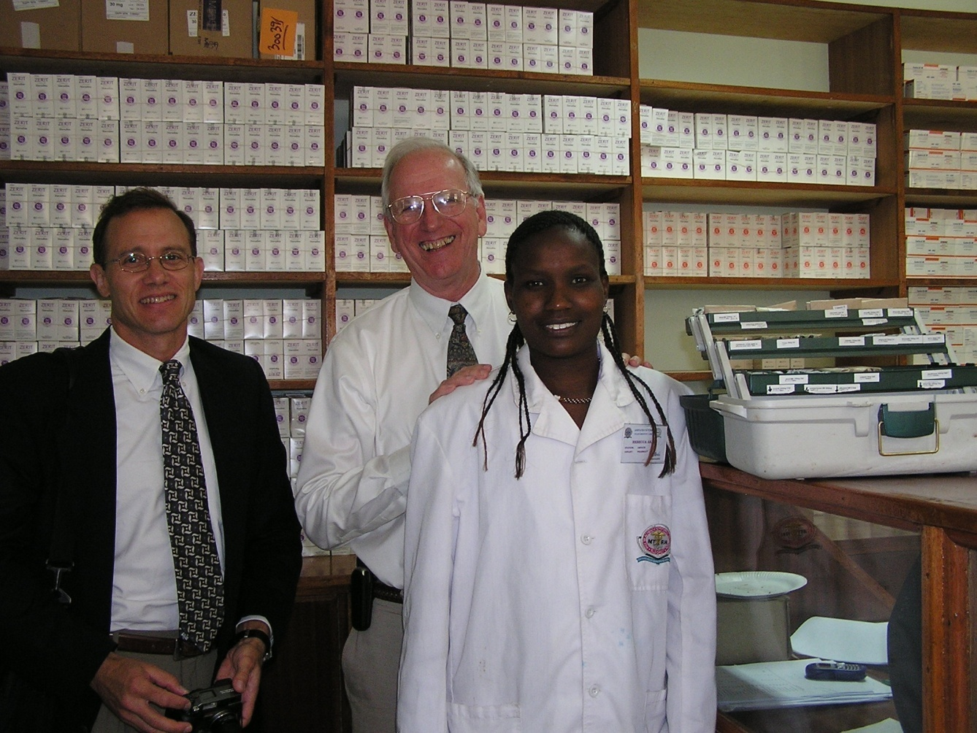
IUPUI and Moi University
Notes:
Our biggest and the model that inspired the others.
Grew from small student exchange in 1989 to:
2 hospitals, 26 clinics, 8 farms, craft workshop, orphanages, food distribution center
Treating 80,000 HIV/AIDS patients a year
Exchanging 20 faculty and 50 students annually
Projects in Education, Social Work, Social Sciences, Law, Informatics, Physical Ed, Engineering, Business, Nursing
Engagement of dozens of community organizations in Indiana and Kenya
Over $100 million in grants
Dean of Medical School: most important thing about the partnership – come back better doctors.

Slide 34
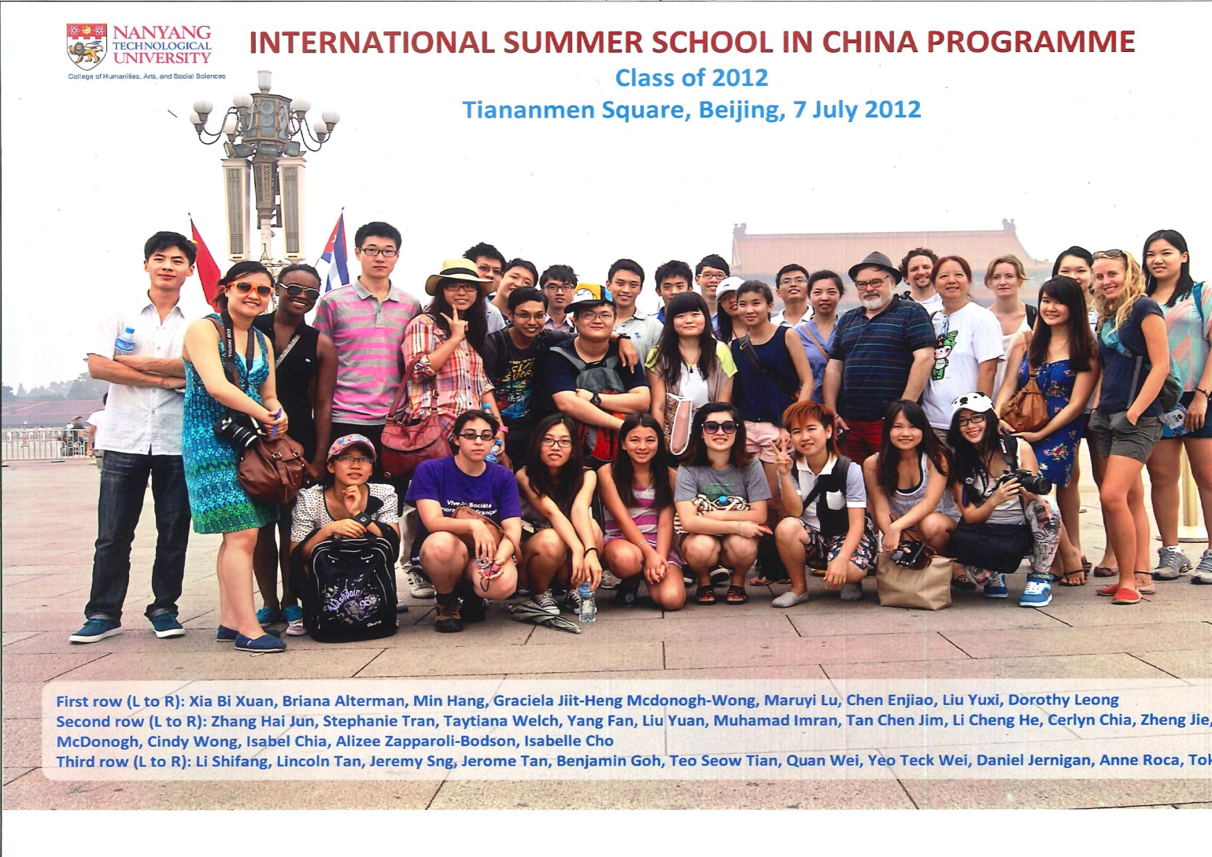

Slide 35
Susan’s fantasy “Greater Goals” of internationalization
To graduate individuals knowledgeable about, at home in, and prepared to lead a globalizing world.
To create transformative, transcendent knowledge from global dialogue and collaboration, knowledge that transforms disciplines, students, faculty, and institutions alike.
To enable higher education to be a force for global good, advancing people-to-people diplomacy and addressing the global issues of our times.
To assist our surrounding communities in navigating the waters of an increasingly globalized world.
To shape a global system of higher education that meets growing demand, is balanced in impact across nations, values different forms and audiences, and operates according to mutually developed standards and principles.

