Slide 1
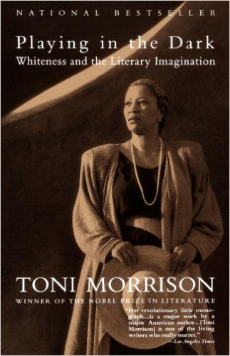
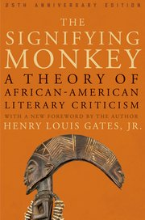
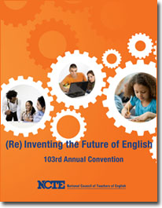
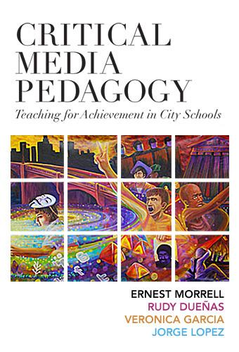
Because it Mattters:
Culturally Relevant Teaching in Today’s Colleges and Universities
Ernest Morrell--Columbia University, Teachers College
Notes:
Good evening and thank you all for coming tonight. Before beginning my formal remarks I would like to thank Professor Dianne Pinderhughes of Africana Studies and Professor Jesse Lander of English and the faculties of their respective departments for inviting me out for this talk.
The title of my talk is On Literatures, Literacies and Liberation and what I have attempted to do is to weave together a narrative of a quarter century of life as a student, a scholar, a teacher, a writer, and a person for, as I get older, I find it increasingly difficult to separate my autobiography from my scholarship. I am the work that I do and I am who I am because of the words I have read and written and because of the students I have taught and loved and learned so much from over these past 24 years. So in 50 minutes or less I promise to get from the beginning up until the present and I will do my best not to go over time as I am the only one standing between all of you and the food and beverages you’ve been promised.

Slide 2
The College Revolution

Slide 3
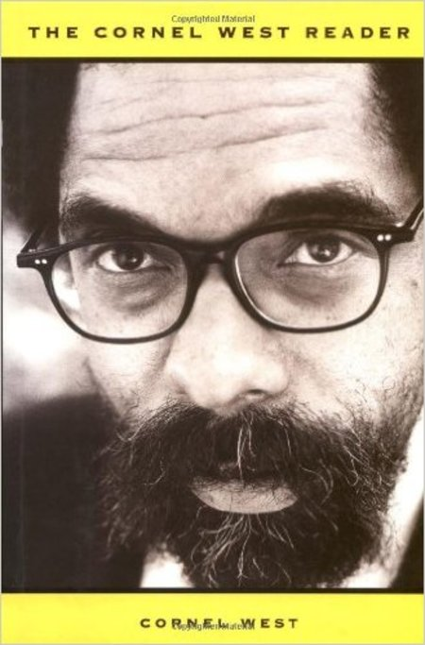
“The two greatest problems in [our] community are too much poverty and too little self love.”—Cornel West (1993)
Notes:
Why English? I believe the first time I heard this question it was almost 25 years ago. I was a junior in the University of California system and I was dropping all of my Economics courses and trading them in for our English Core and a fat Norton Anthology, one I still possess…I still find myself asking (and being asked) this question of why. Why would you leave a promising career in Finance? Why do we need to study a language that we speak almost at birth? Why study a discipline that, at times, pretends that “we” in air quotes, have nothing to contribute to it? And why, in a time of global competition and technological advancement, should anyone be left alone to stare at the clouds and contemplate Keats and Tennyson? As president of the National Council of Teachers of English from 2011 to 2015 I was asked these and similar questions directly from staffers, senators, and congressional representatives as I sat in their plush DC offices on our annual advocacy day.
While there are many places that I could begin to formulate a response, in preparing these remarks I was drawn to this quote from Cornel West. A philosopher (and now colleague) that I met at this very moment in my life. The day was April 29, 1992 and, after a jury found the officers videotaped beating Rodney King not guilty, it was LA that was burning (and not Charlotte or Ferguson or Baltimore) and I had just turned 21, having met my wife of now 23 years only 5 days prior. Naturally, like all of my classmates I dropped everything and took to the streets. I returned to my classes different, somewhat liberated, exhausted, somewhat devastated and in search of a different pathway forward, I turned to a cassette tape (yes a cassette tape) sent to me by a friend of a talk delivered by Doctor West to students at Bowdoin where he began with the quote you now see behind me. The talk (essentially a precursor to his now much acclaimed book Race Matters) once again pointed me back to English and away from the law school-MBA applications that adorned my Southern California dorm room. For, in English, I found my own pathway toward self love and meaningful cultural production. A quarter of a century later, I am still here, and I am happily here. At the risk of sounding sacrilegious I must say that it was English that saved me...I am here because I continue to place English at the forefront of humanities disciplines that can intervene in the lack of self knowledge, and self love demanded for active citizenship…
BUT...it is in the spirit of love that I continue to question English and my place in it, and today’s talk will reflect many of those questions and the answers I’ve found. And maybe they shed some light on why I am as happy as ever to be here “In English” and why I hope to never leave.

Slide 4
“Once you learn to read you are forever free”
Frederick Douglass
#PowerofLiteracy
“For these are all our children.” James Baldwin
© Pam Allyn 2015

Slide 5
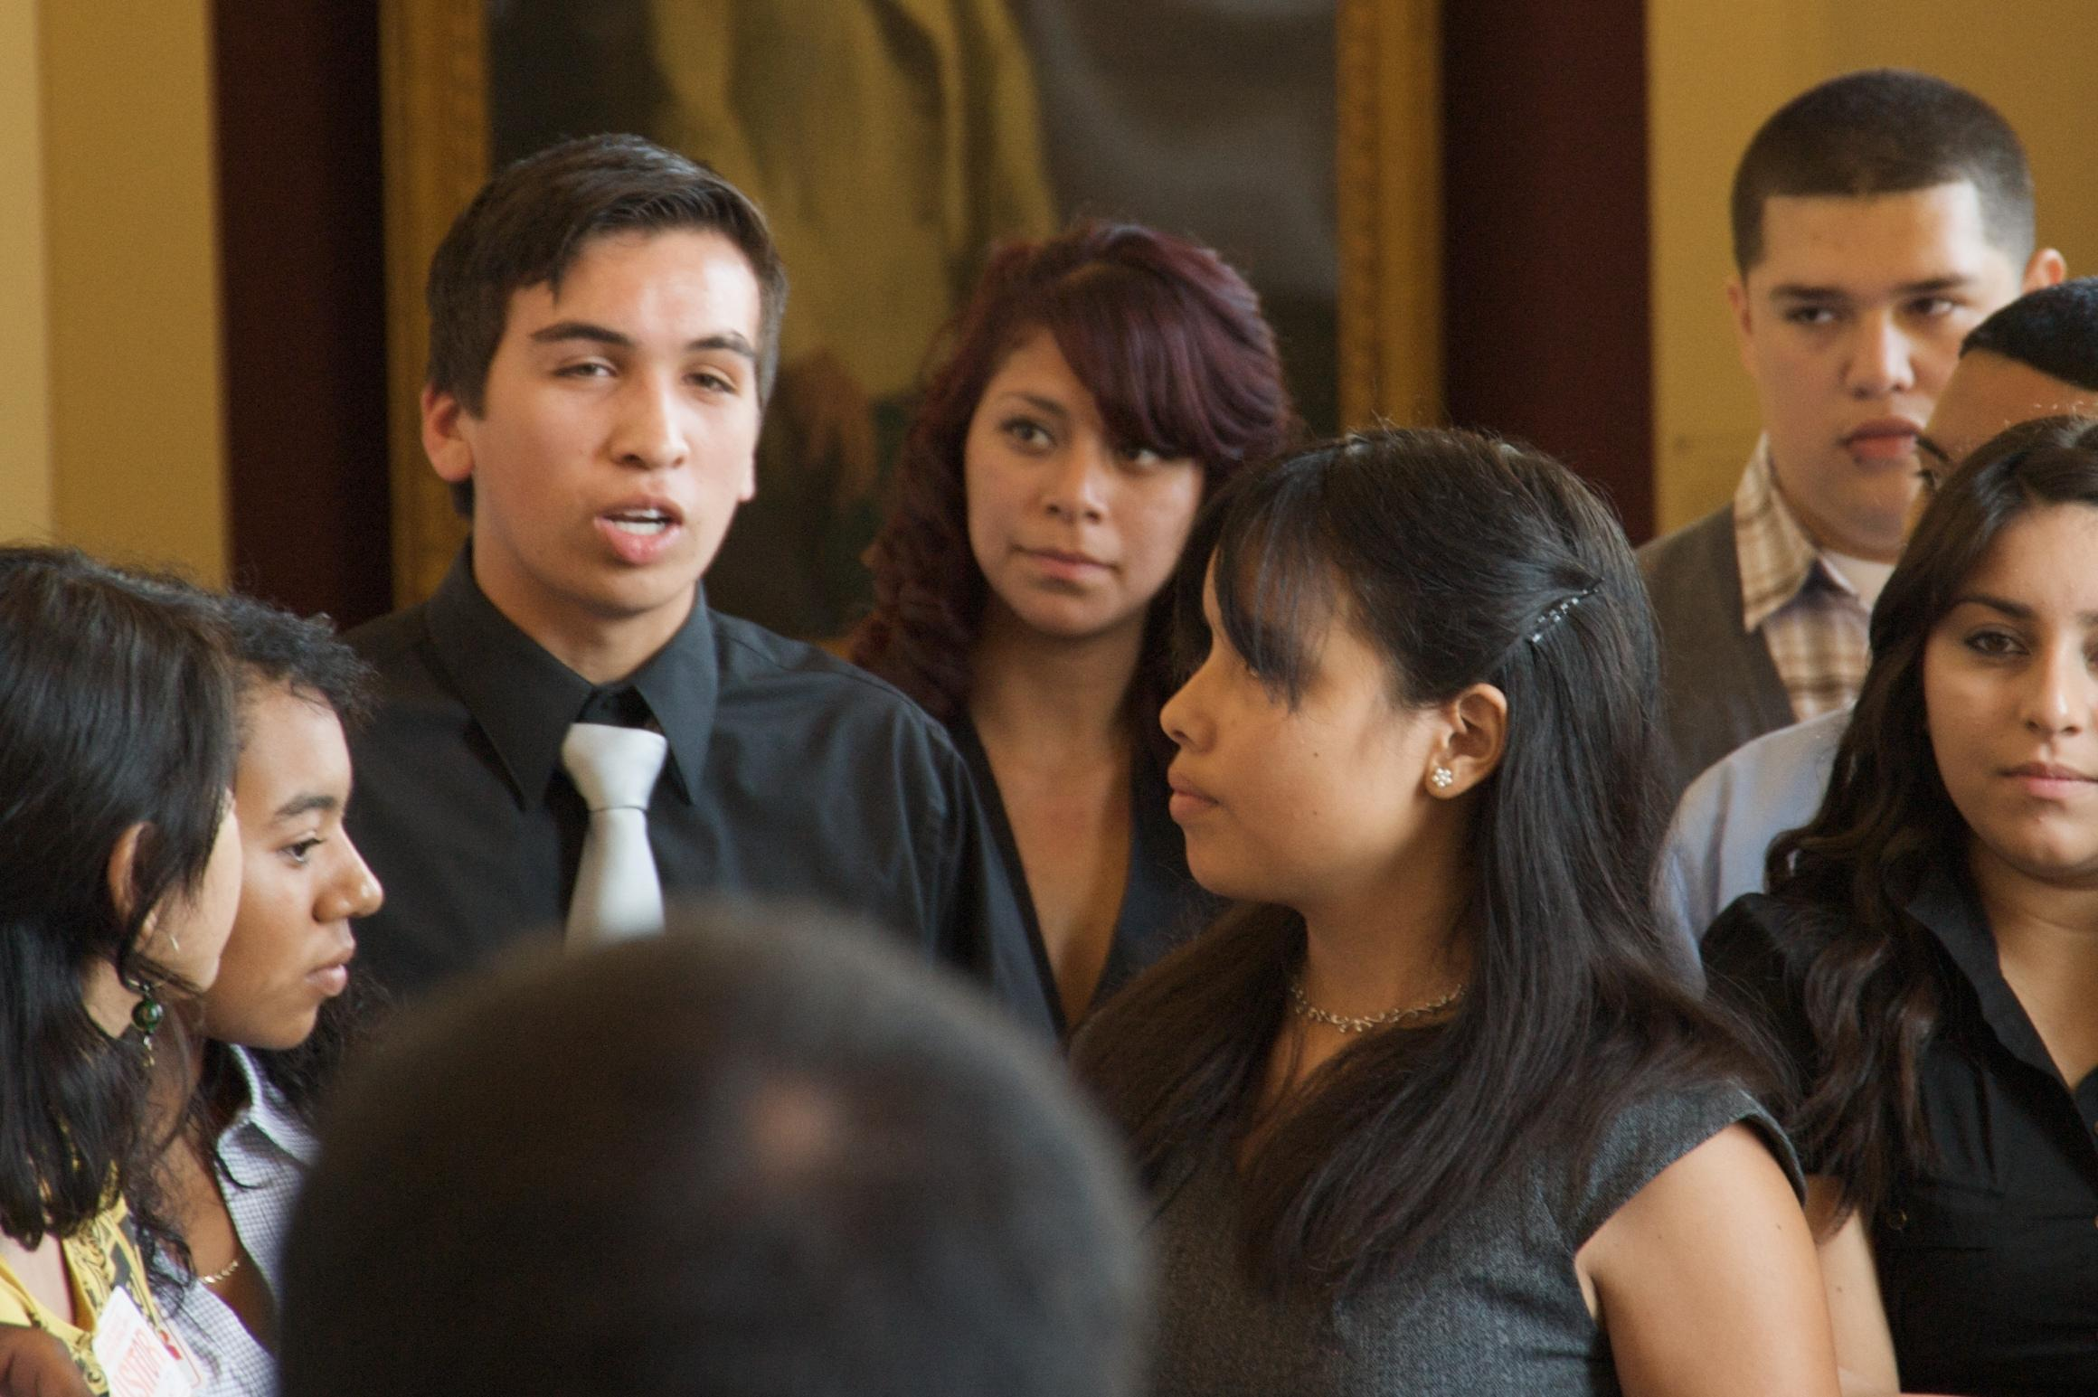
Inspiring Literate Lives

Slide 6
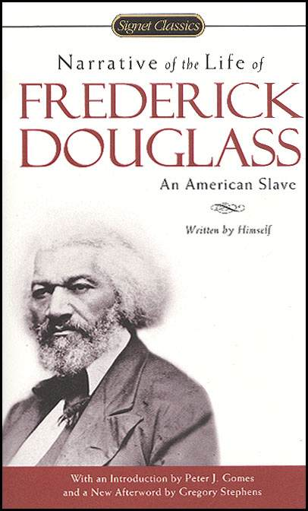
On Literacy and Liberation
The reading of these speeches added much to my limited stock of language, and enabled me to give tongue to many interesting thoughts which had often flashed through my mind and died away for want of words in which to give them utterance. The mighty power and heart-searching directness of truth penetrating the heart of a slave-holder, compelling him to yield up his earthly interests to the claims of eternal justice, were finely illustrated in the dialogue; and from the speeches of Sheridan I got a bold and powerful denunciation of oppression and a most brilliant vindication of the rights of man. Here was indeed a noble acquisition. If I had ever wavered under the consideration that the Almighty, in some way, had ordained slavery, and willed my enslavement for His own glory, I wavered no longer. –Frederick Douglass
Notes:
I often begin my graduate courses on the teaching of African American literature with the narratives of Frederick Douglass and Harriet Jacobs both an introduction to African American literature, but also setting the stage as literacy as an act of freedom; rhetorical power and the constitution of the self and the social.
We learn a great deal from these narratives that inform this question of Why English particularly an English that sees itself as engaged in conversations about literatures, literacies, and liberation. Douglass, in this passage written almost at the exact moment that Father Sorin was laying claim to a beautiful spot of earth in Northern Indiana, speaks powerfully to the role of literacy in his path towards self liberation, but he also speaks powerfully as an author, in the literary tradition, through a work of literature that provoked a young nation at its conscience. Almost 170 years later we still call on Douglass as literacy theorist and as literary icon. Our discipline needs to provide this cultural history as well as the call to action; it will maintain its power by continuing to provide access to life-changing literacies and literatures. To make possible a freedom with words through engaging words of freedom.

Slide 7
Four Dimensions of Culturally Relevant Teaching
Socio-Critical
Global
Digital
Social

Slide 8
Towards a Critical Pedagogy of College Teaching Education for Critical Consciousness: Paulo Freire (1921-1997)
Humanizing Education
Reading the World
“True education must begin with the experiences of the people.”
Banking education treats students as empty repositories while a problem-posing education treats them as humans.
Notes:
I join a chorus of scholars like Robert Scholes, Geneva Smitherman, Keith Gilyard, Gerald Graff, Anne Gere, and Arthur Applebee who have been strong proponents of an increased pedagogical focus in English studies. My ideas about the pedagogy of English have been largely formed by Paulo Freire and other adherents of what we have been calling critical pedagogy. Paulo Freire, a Brazilian literacy educator and education advisor to the World Council of Churches believed that education held the potential to enhance conditions of either oppression or liberation. In Pedagogy of the Oppressed, written while in exile at Harvard in the late 1960s, Freire identified banking education, as the primary method by which educational institutions maintain oppressive ideologies. According to his banking metaphor, schools or educational institutions treat students as empty repositories waiting to be filled by institutionally sanctioned knowledge, even if possessing that knowledge was detrimental to students’ sense of self.
Freire argued instead for a problem-posing education, an education rooted in the existential experiences of the people, in which they explored their own immediate surrounding and, in an attempt to become more present in understanding and reshaping their own reality, also gain important academic and critical literacy skills. I would like to briefly describe two book-length projects that explain how my work has been shaped by and hopefully has shaped critical pedagogical studies
In The Art of Critical Pedagogy: Possibilities of Moving from Theory to Practice in Urban Schools Jeff Duncan-Andrade and I explore critical pedagogy and its practical applications for the Teaching of English. It addresses two looming, yet under-explored questions that have emerged with the ascendancy of critical pedagogy in the educational discourse: (1) What does critical pedagogy look like in urban secondary English classrooms? and (2) How can a systematic investigation of critical work enacted in urban contexts simultaneously draw upon and push the core tenets of critical pedagogy? Addressing the tensions inherent in enacting critical pedagogy —between working to disrupt and to successfully navigate oppressive institutionalized structures, —The Art of Critical Pedagogy seeks to generate authentic internal and external dialogues among English educators in search of literary texts and classroom practices that contribute towards a more socially just world.
A yet unfinished manuscript Critical Pedagogy and Cultural Studies in English Education: An Introduction (Routledge). This book, intended for undergraduate and graduate courses, will consider the potential of conceptual and empirical work in critical pedagogy and cultural studies to inform, confront and transform many of the persistent challenges we presently face in urban education. The book begins with an examination of the historical antecedents of critical pedagogy, both from the Western philosophical tradition and “Othered” traditions such as the African-American and Latin American traditions and Postcolonialism. The book will then examine the theory and research of critical pedagogists such as Paulo Freire, Sonia Nieto, Carlos Torres, Peter McLaren, Henry Giroux, Antonia Darder, and bell hooks. The second half of the book will focus on cultural studies and, in particular, the critical uses of popular culture in secondary and college English classrooms. Examples will focus on hip-hop and spoken word poetry, film, television, mass media consumption and production and their implications for transformative work with the post-millennial generation.
An explicit focus on critical pedagogy in and for English become necessary when we consider the Who and Where of English to which I will now turn...

Slide 9
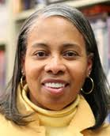
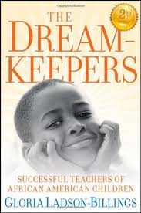
Culturally Relevant College Teaching Gloria Ladson Billings
Students must experience academic success
Students must develop and/or maintain cultural competence
Students must develop a critical consciousness through which they challenge the status quo of the social order

Slide 10
21st Century Learning Ecologies
Moving from a receptive century to a productive century
Learning that is participatory and interactive
Learning to critically discern when inundated with information
Learning that allows students to develop their own unique and powerful voices
Learning how to listen to and consider others' diverse perspectives
A 21st century curriculum needs to offer spaces for collaboration, presentation, and invention

Slide 11
Learning is Becoming

Slide 12
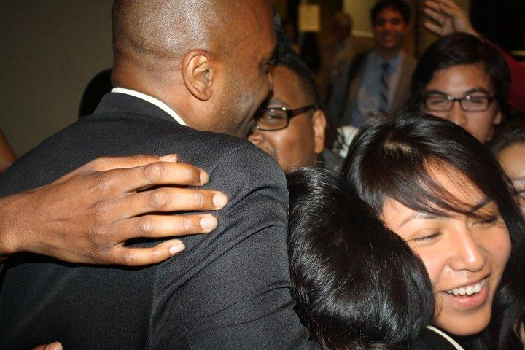
A Social Emotional Framework
Self
Knowing that I fit
Knowing that I matter
Others
Awareness of others
Kindness towards others
World
The world needs me
I can help
I am willing to face challenges and overcome obstacles

Slide 13
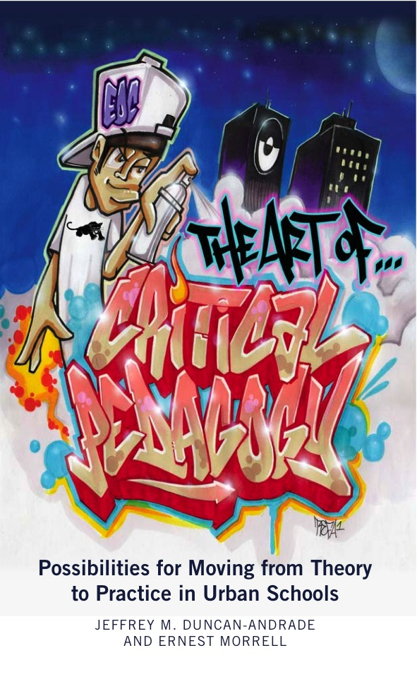
Critical Literacies and “Social” Change
Changing Sense of Self (Radical Self Love)
Changing our relationships with others (Intersubjectivity)
Changing the world)

Slide 14
The African Diaspora as Imagined Community

Slide 15
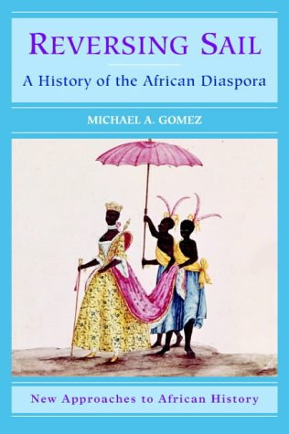
Quantifying Africa and the Diaspora
Were it a nation, the African Diaspora would be the third largest nation on the planet
Brazil alone has over 100 million African Diaspora residents.
By 2050, 40% of the births globally will be to children who are African or of the African Diaspora.
By 2100 40% of the earth’s population will have its origin in sub-Saharan Africa.
Notes:
Were it a nation the African Diaspora would be the third largest country on earth, behind only China and India, and ahead of the United States. Taken together Africa and the African Diaspora represent 20% of the world’s population and an even greater percentage of the world’s growth and the growth of the Catholic Church. By 2050 40% of all births will occur in sub-Saharan Africa and by 2100 40% of the world’s population could live in or hail immediately from Africa. This represents a significant and fast growing population that we know relatively little about from a scholarly perspective. What we do know is that the continent has the lowest life expectancies and some of the lowest literacy rates on the planet. We also know that its artists, its heroes, its priests and bishops, its educators, its cultural institutions, and its martyrs are largely unknown and understudied by the Western world. Hierarchies of knowledge, legacies of enslavement and exploitation, and academic structures that lean toward Europe have prevented the serious study of the African Continent and African Diaspora that are warranted. More than 175 million Africans are Catholics and there are another 100+ million Catholics in the African Diaspora. Brazil, with a 50% African Diaspora population, has more Catholics (at 140 million) than any nation in the world.

Slide 16
The Silence of the Archive
The Archive is the Form by which knowledge is made visible or knowable.
Q: What is lost when the “shelves” are empty?
What are the consequences for the subject and for society?
Building the Archive as a revolutionary (and scholarly) act!
Notes:
But whose words are words of freedom and for whom? In addition to the “Why” of English I also ask about the Who, the What, the Where, and the How of English. In asking these questions, in seeking the incorporation of new literatures, new geographical boundaries, new pedagogical perspectives, and a broader spectrum of participants I am forced to consider the silence of the archive…
The location of the work of the Discourse analyst is the archive but, what do we do when the archives do not exist to make the knowledge visible or knowable? The analyst must necessarily becomes a producer of archive; a collector of texts, and narratives. A digger, an archaeologist if you will. I find that increasingly I have become a collector (and assembler) of forbidden or forgotten words, of stories of texts and writers, a rememberer and a documentarian of the myriad sociocultural contexts amid which texts are constructed, consumed, and distributed. Our ability to put our thumbs on discourse, so to speak, is only as possible as the archive shelves are full. Empty shelves and muted voices limit our ability to do our work in English. As you know, I have particularly been concerned with the absence in the academic archives of the powerful voices of the African Diaspora, thus my dual foci on English and Africana Studies.

Slide 17
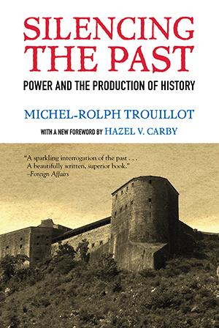
Un-Silencing the Past
The Power of the Story
•Silences enter the process of historical (and cultural) production at 4 crucial moments:
•1-SOURCES- the moment of fact creation (making sources)
•2-ARCHIVES-the moment of fact assembly (making archives)
•3-NARRATIVES- the moment of fact retrieval (making narratives)
•4-HISTORY-the moment of retrospective significance (making history)
(New Texts, New Authors, New Readings of Texts)
Notes:
In Silencing the Past Michel-Rolph Truillot explains that Silences enter the process of historical (and cultural) production at 4 crucial moments: 1-SOURCES- the moment of fact creation •2-ARCHIVES-the moment of fact assembly; 3-NARRATIVES- the moment of fact retrieval; and •4-HISTORY-the moment of retrospective significance What are the sources of English, what are the archives (and who does the work of archiving), what are the narratives (who writes them and for what audiences)? Who tells the (his)story of English?
Only through integrating the archives do we allow the possibility of an engaged and transformative scholarship that speaks the truth to power, that makes subjectivity possible. And it is possible. Michel Foucault reminds us that “We must cease once and for all to describe the effects of power in negative terms: it ‘excludes’, it ‘represses’, it ‘censors’, it ‘abstracts’, it ‘masks’, it ‘conceals’. In fact power produces; it produces reality; it produces domains of objects and rituals of truth. The individual and the knowledge that may be gained of him (or her) belong to this production’ (Foucault 1991: 194). Truly transformative discourse analysis can un-Silence the past; it’s archaeological digs can unearth agency and power filling cultural voids and challenging narratives of powerlessness. Discourse, at least as Foucault sees it, is at once a location of regime making and countercultural production. When we act as analyzers of discourse and excavators of the lost or hidden cultural knowledge in literary texts and popular artifacts, we participate in the act of unsilencing.

Slide 18
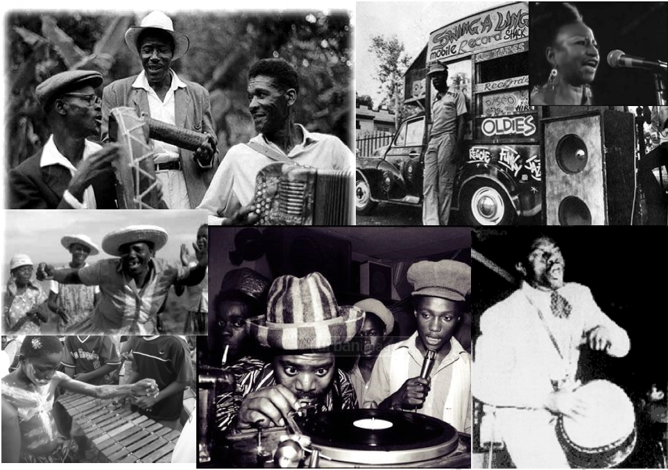
Teaching the African Diaspora

Slide 19
The Theoretical Framework
Imperialism
Resistance
Cultural Practice

Slide 20
The Pedagogical Model
Challenging, but energizing curriculum
Academic and Popular Cultural Resources
Digitally Relevant Pedagogy
Focus on Anti-Colonial, Postcolonial, and Critical Race Theory
Intersectionality of race, class, gender, and geography
Students learn through engagement, research, and authentic interaction with multiple audiences

Slide 21
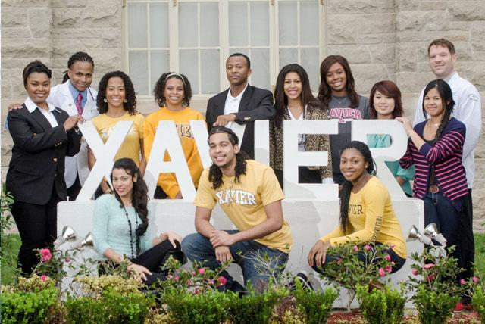
African Diaspora Global Student Exchange

Slide 22
Theoretical Framework
Social Justice
Academic Research
Citizen Service
Social Entrepreneurship
Among College Students in their Sophomore Year

Slide 23
ADGSE Desired Outcomes
Overcoming the “5 F’s” impeding African descendant students’ study abroad (Family, Faculty, Finances, Fear, & Friends)
More meaningful global experiences
Development of measurable understandings of the historical time, space, and cultural contributions of populations across the African Diaspora
The development of young leaders who have a broader understanding of globalization and its cultural interconnectedness

Slide 24
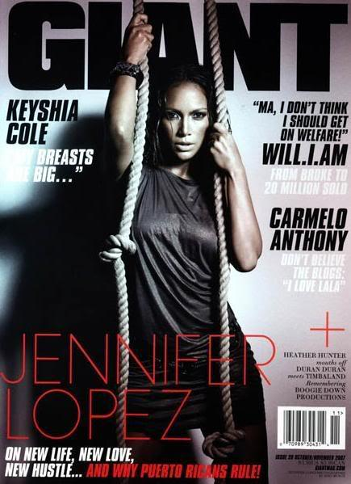
Critical Media Pedagogy
Media Consumption Understanding of the role of media in perpetuating cultural hegemony
Media Production. Becoming skillful and willful producers and curators of media content
Media Distribution. Willingness and ability to distribute media content.
Media Invention-Creating New Media Technologies

Slide 25
Visual Literacies
How are literacies changing in the digital age?
What does it mean to read these texts?

Slide 26
Reading 1950s Advertisements

Slide 30
Reading Film
NY Times Film in the Classroom
http://learning.blogs.nytimes.com/teaching-topics/film-in-the-classroom/?_r=0

Slide 31
Critical Media Consumption
Students doing critical discourse analysis of news media content
Frequency counts and content analyses for references to youth from inner cities

Slide 32
Critical Media Production Q: How do Your Students Produce Media Content?
Google Apps
Digital Filmmaking
Spoken Word Poetry and Hip Hop
Twitter
Instagram
SnapChat

Slide 33
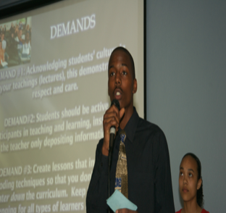
Participatory Research & Social Action

Slide 34
The Process
Identify a problem
Develop a Question
Design a study
Collect data
Analyze Data
Make Claims
Provide Evidence
Create Products
Disseminate Products
Social Action
Notes:
The work is not part of a field trip to the local schools and communities and while the process is intended to develop individual literacy skills and facilitate personal transformations, its also important for us that the student research be legitimate and make legitimate contributions to the project of educational and social justice. The students have generated work that has made a difference in the issues that matter most to them, their peers, and their communities. [IN THE CHAPTER I CAN PULL OUT EXAMPLES THAT FLESH OUT EACH OF THE BULLET POINTS LISTED ABOVE]
We must realize that youth have to become important co-participants, its important to their pedagogy and its important to move toward the outcomes we want in urban education.

Slide 35
First Wave- University of Wisconsin Rap Opera and Literary Production in College English
Notes:
In 2013, during my term as President of the National Council of Teachers, I chaired the annual convention in Boston Massachusetts, which brought 8000 participants from elementary, middle, high school, and college departments. Part of the responsibility of the chair includes selecting keynote speakers for the General Session. I knew that I wanted to include visions of the possible English so I commissioned First Wave, a Spoken Word group at the University of Wisconsin to create a performance specifically for English teachers and professors. Led by professor Maisha Winn First Wave conducted tryouts and created a class that explored themes in English studies while the students, all English majors, created an original rap opera that they performed before an audience of 1500 educators a the convention. Watching the hip hop opera performed live before an audience of 1500 English faculty remains my singular fondest memory of my presidential term and perhaps in my 23 years as a member of this professional organization.

Slide 37
Inequality of Education
Historically and currently,
South Central Los Angeles schools have lacked the necessary resources needed to provide a quality and effective education
“Despite greater need, 79% of large city districts studied by the Council of Greater City Schools are funded at a lower rate than are suburban schools; nationally, advantaged suburban schools spend as much as ten times that spent by urban poor schools”
(Anyon 1997)
Notes:
The economic crisis in the community also has an impact on school which leads us to our second claim. (State claim)
According to Anyon even with the greater needs of urban poor schools they are still being funded at a lower rate then most of suburban schools.

Slide 38
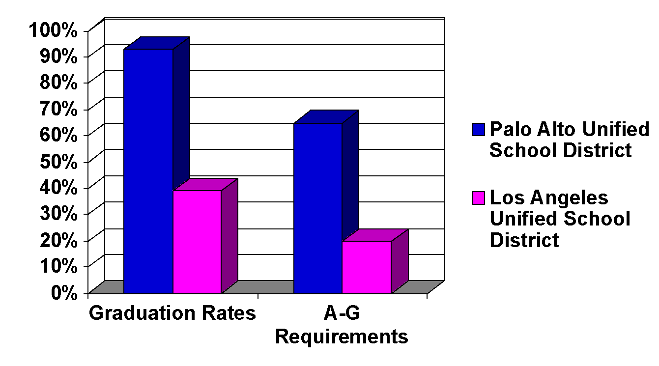
Graduation Rates & A-G Requirements
Median household
income:
Palo Alto –
$90,377
South Central L.A. –
$34,069
93%
65%
39%
20%
California Educational Opportunity Report
UCLA/IDEA 2007
Notes:
These low resources have a significant impact. when compared to other districts LAUSD students perform at a significantly lower rate
Take for example in 2007 the palo alto district which has a median household income of 90,377 as compared to the median household income of 34,069 in south Central L.A. - the graduation for palo alto is 93% when Lausd ‘s 39% isn’t even half of their graduation rates and when it comes to students graduating with a-g requirements palo alto’s rate is 65% which is more then half of its graduated students and three time more than lausd’s rate which is 20%

Slide 39
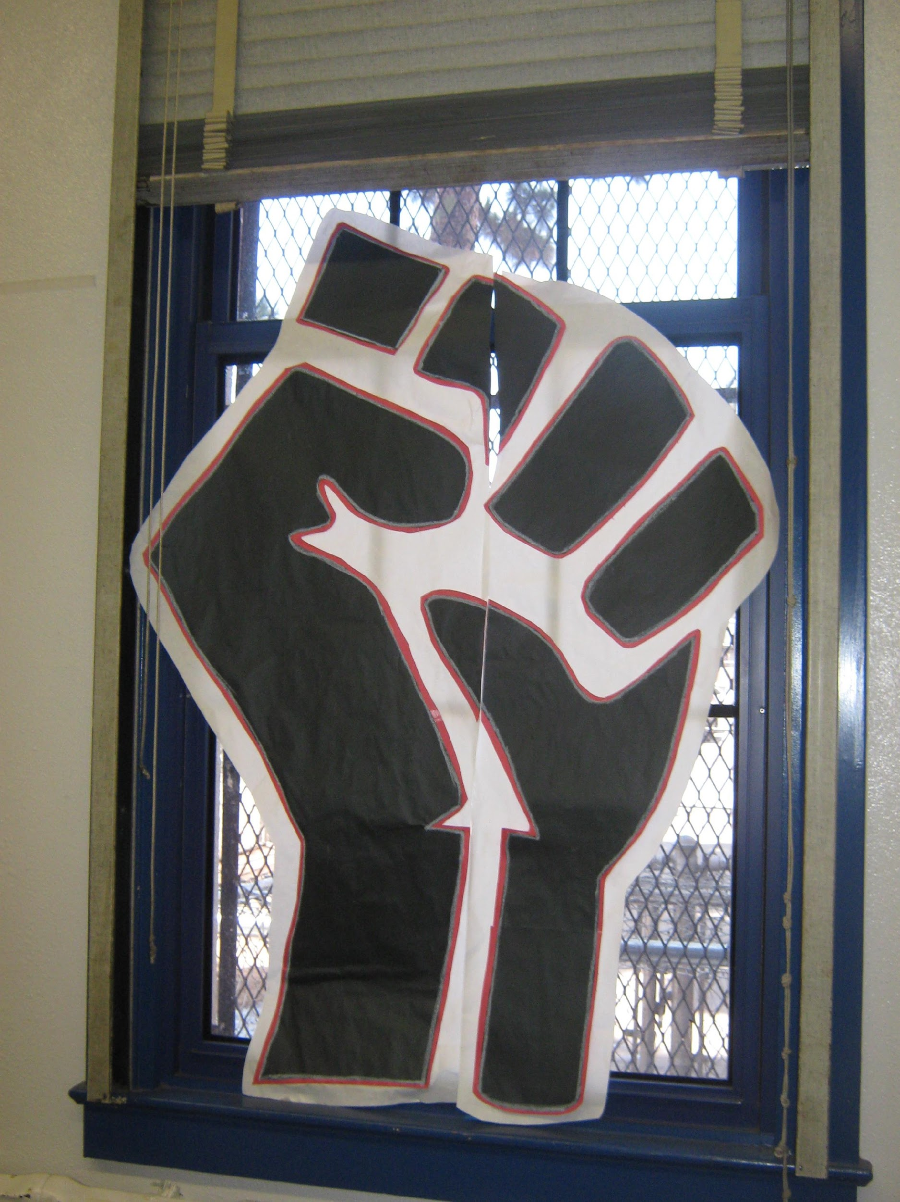
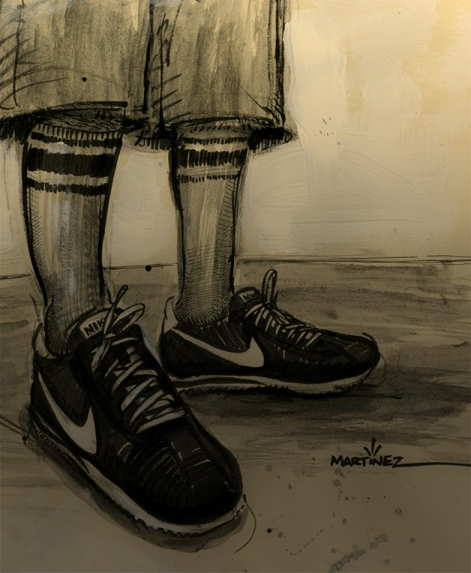
Demands
Step Into Our Shoes
Radical Truth-Telling
Notes:
Greg

Slide 40
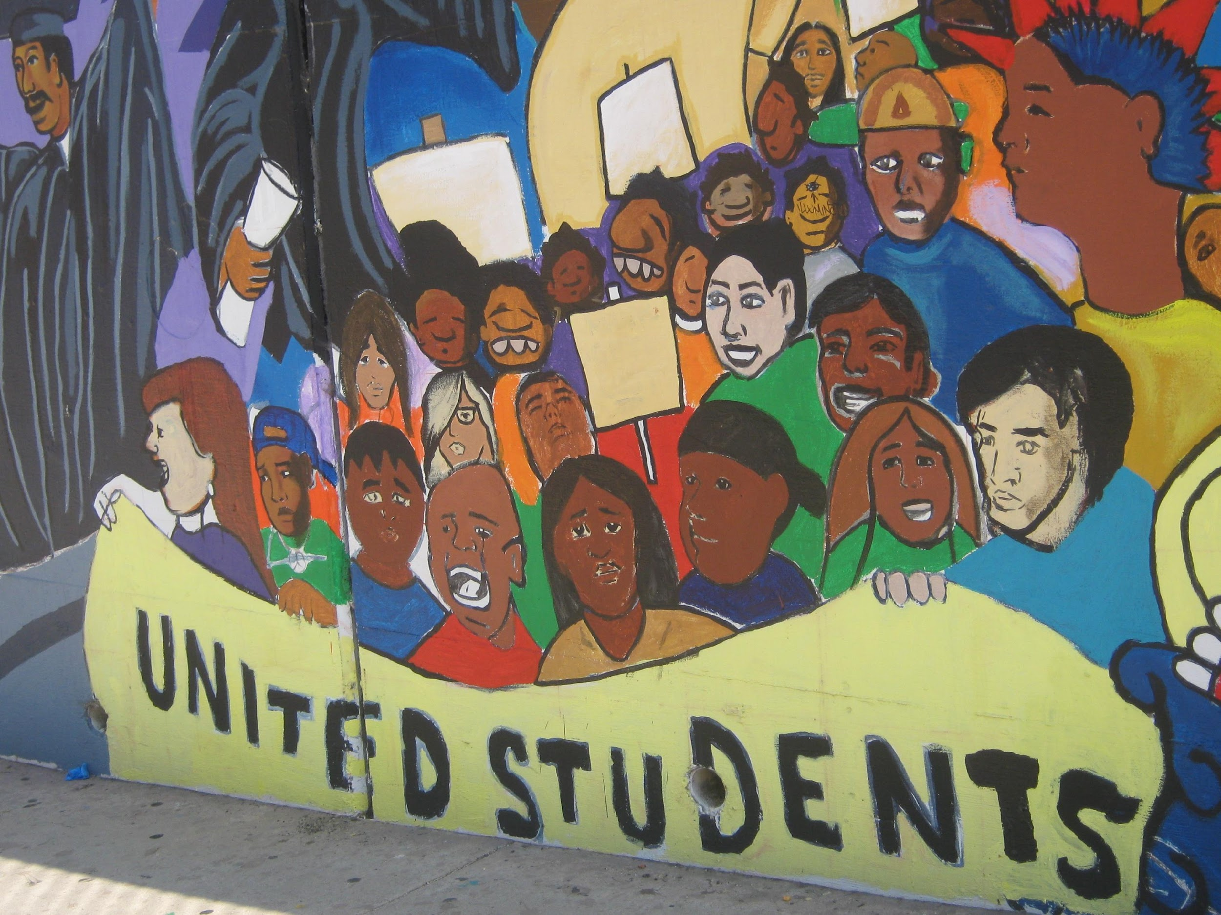
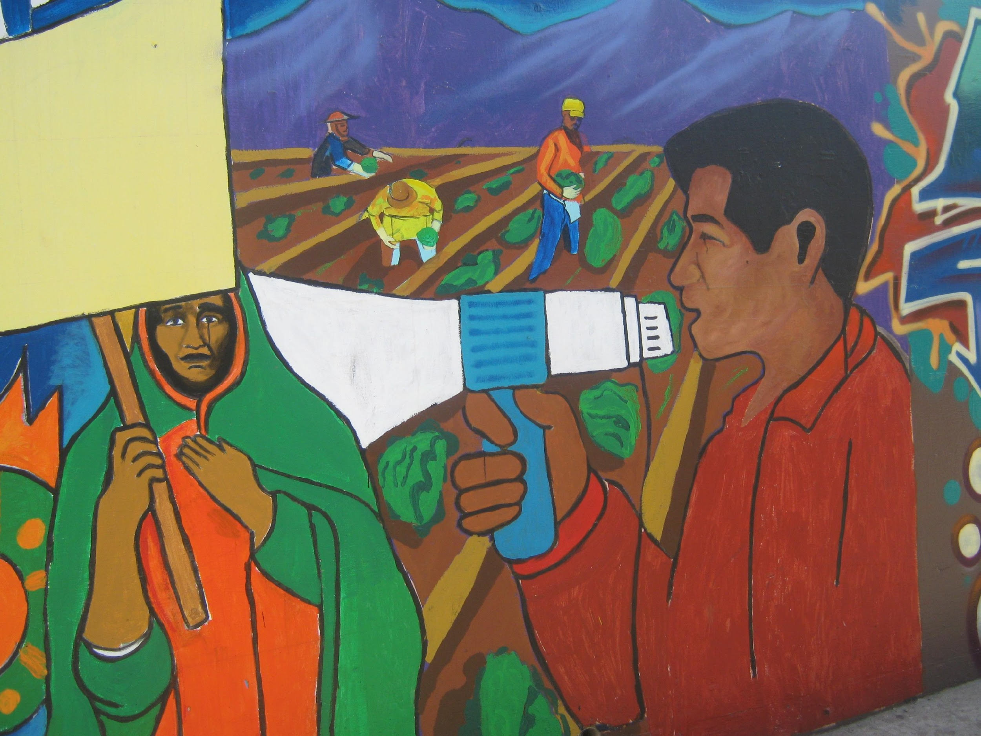
Action Plan for Families
Students: Learn about your school-site council (become a student representative and share the information you learn with others)
Parents: Educate yourself about the platforms of politicians running for office in 2010 (VOTE or encourage others to exercise their right to vote)

Slide 41
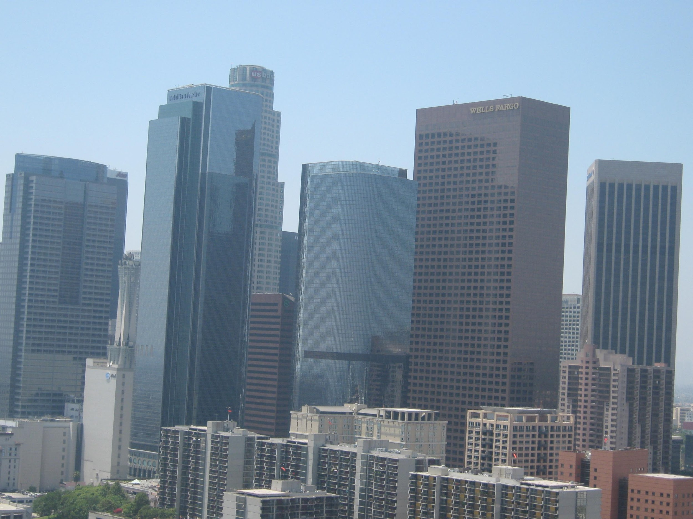
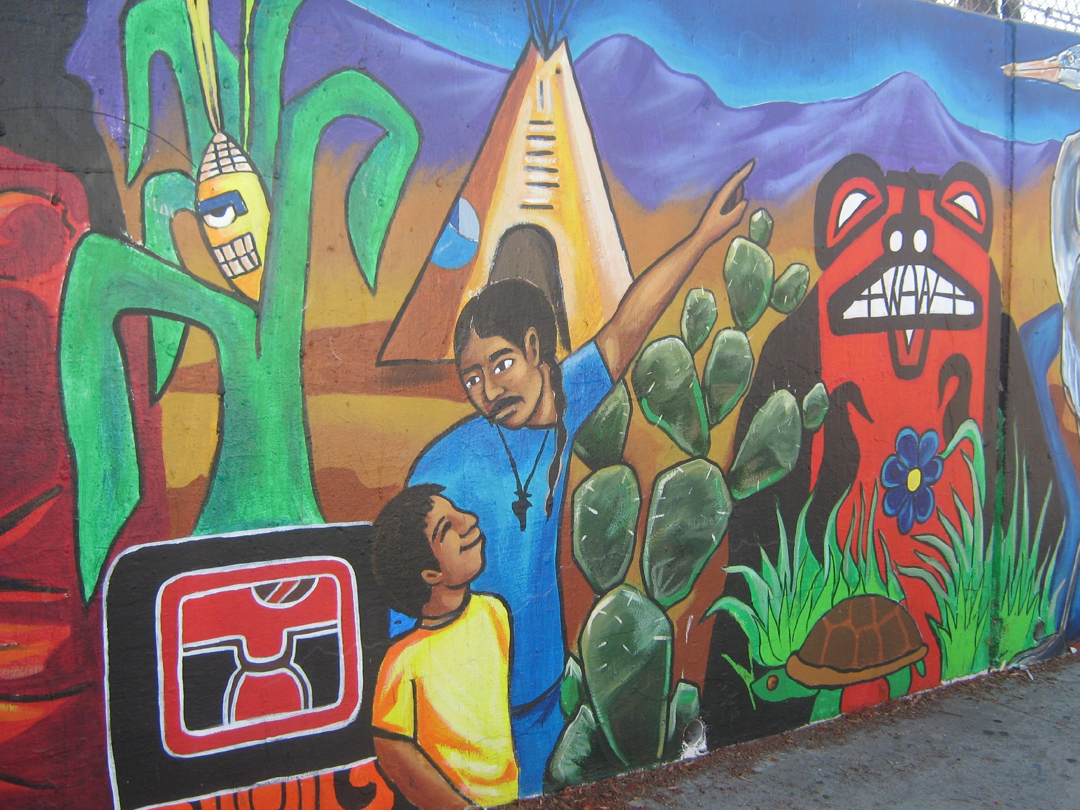
Action Plan for Community Leaders
Policy-makers: Streamline communication between school district and city officials to develop a comprehensive plan to help homeless youth and families.
Teachers: Create lessons that connect your subject to the economic crisis (organize student focus groups)
Notes:
Emily and erick

Slide 42
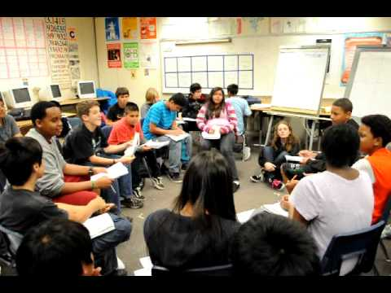
Beautiful Noise Improving Classroom Talk in the Polyvocal Classroom
Socratic Discussion Talk
Small Group Discussion Talk
Formal Presentation Talk
Mock Trial/Forensic Debate
Electronic Communication

Slide 43
Improving Socratic Discussions
Modeling thinking out loud
Scripts
Active Listening
Open ended questioning
Appropriate Turn Taking
Socratic Voice
Teacher Led-Student-Centered

Slide 44
Improving Small Group Discussions
The formation
Co-facilitation
Interdependency
Small group voice
Turns (length & frequency)
How to use notes
Student led-Student Centered

Slide 45
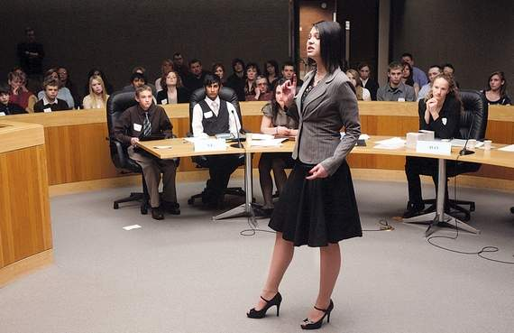
Classroom Debate
Developing Arguments
Anticipating counterarguments
Oral language
Quick rounds
The format
Notes and preparation

Slide 46
Multimodal Presentations
Rhetorical Situation
Audience
Effective incorporation of technology
Vocal exercises
Starting Slowly
Body language & attitude
Performance

Slide 47
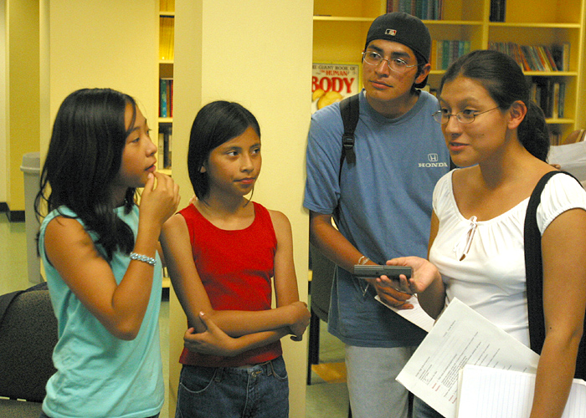
The Promise
College Persistence
Academic Literacy
Digital Literacies
Stronger Disciplines
Faculty Engagement
Self Love/Self Healing
Safer Campuses
Social Action

Slide 48
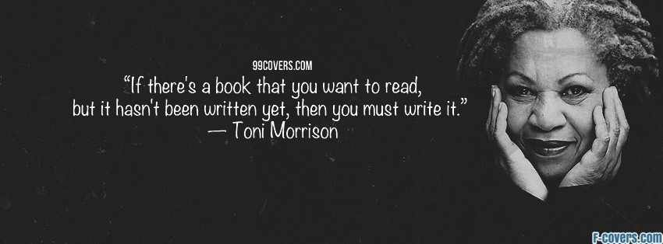
Reading the Past, Writing the Future

Slide 49
What I’ve Learned from Mom and Dad What WE do matters! “I wanted to retire a dreamer” “Don’t let anyone take away the privilege of teaching” “Teaching makes you eternal…”

Slide 50
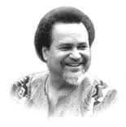
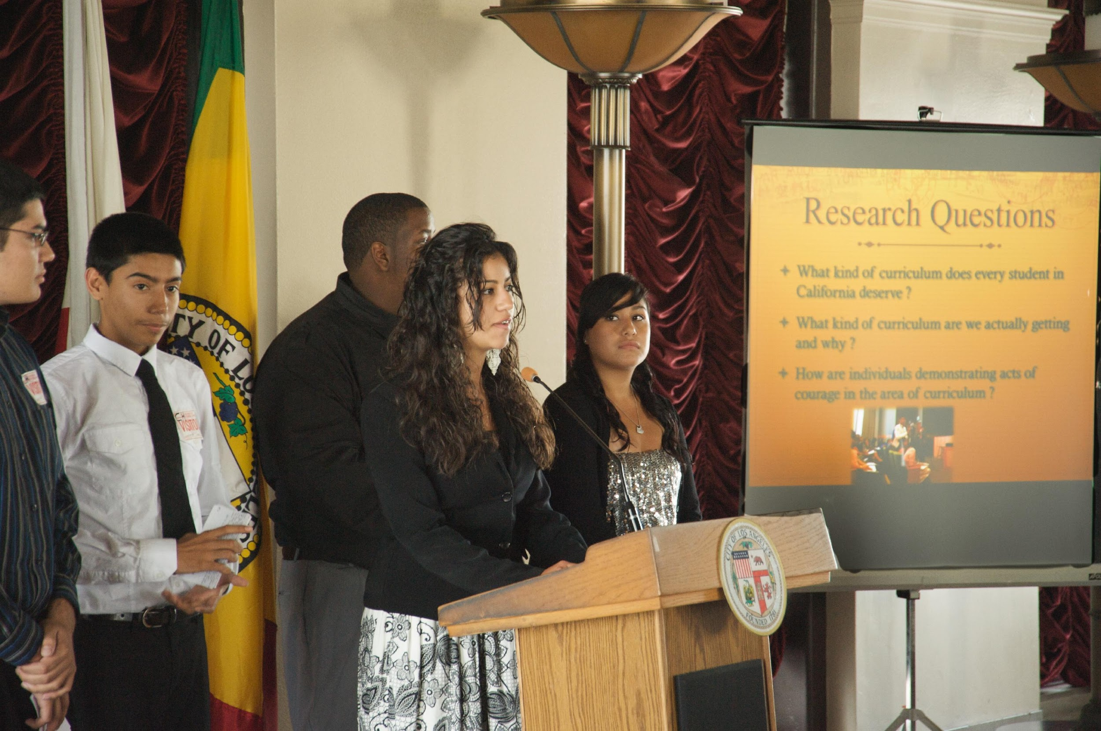
Teaching as an act of LOVE!
“I have never encountered any children in any group who are not geniuses. There is no mystery on how to teach them. The first thing you do is treat them like human beings and the second thing you do is love them”- Asa Hilliard

