Slide 1
Expanding Social Media Literacies Through Social Media Analytics
Nathan J. Carpenter, Ph.D.
njcarpe@ilstu.edu
School of Communication

Slide 2
Assumptions about Social Media
“Social media platforms are mostly for entertainment and have become a negative distraction.”
approximately 60% of Americans get their news via social media platforms
69% of adults in U.S. use social media; 34% of adults in U.S. age 65 +
“Young people are experts in social media because they are already immersed in it.”
Familiarity does not equate with competence
Personal networks are very different from public networks
“We don’t teach public relations, marketing, or journalism, so we don’t need to address social media in our fields.”
opportunities to engage with the public, have conversations in the discipline, network with other professionals

Slide 3
Overview
Part One: Framework for Social Media Literacy
Part Two: Core Concepts in Social Media Analytics
Part Three: Examples of Analytics in the Classroom

Slide 4
Part One
Framework for Social Media Literacy

Slide 5
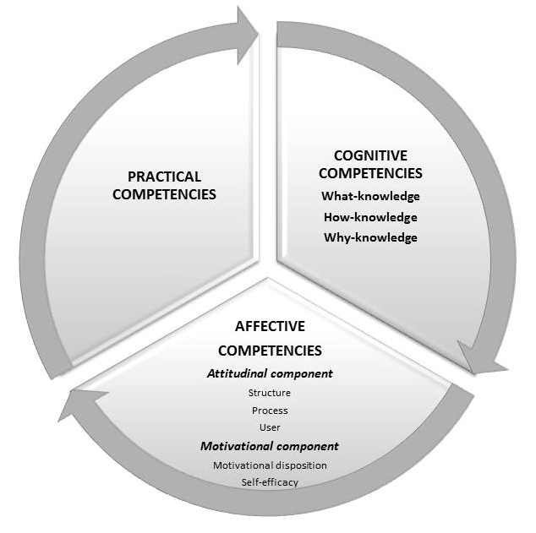
Framework for Social Media Literacy
What are the competencies required for participation?
Vanwynsberghe, Hadewijch; and Verdegem, Pieter (2013). "Integrating Social Media in Education." CLCWeb: Comparative Literature and
Culture 15.3

Slide 6
Practical Competencies
Having access to computers / smartphones
Knowing how to open a web browser and log into an account
Ability to open and read content
Writing and deploying computer code

Slide 7
Cognitive Competencies
What-knowledge
Basic knowledge needed to access media technologies, content, or services
Knowing what settings are relevant and how to change them
Knowing the conventions of a platform (hashtags, mentions, reactions, etc.)
How- / why-knowledge
Analytical knowledge and critical thinking
Who is the producer of a message and why are they communicating?
How do social media create different public spaces?
How do we understand the political, cultural, social and historical contexts of social media content?

Slide 8
Affective Competencies
Acknowledging attitudes
How does one perceive interactivity?
How does one perceive exchanging information?
How does one perceive other users?
Understanding One’s Motivation
How can one enhance one’s skills or gain a positive reaction from others?
Does one believe one has the necessary skills to perform online activities?

Slide 9
Framework for Social Media Literacy
Deal with uses and consequences of social media use
Vanwynsberghe, Hadewijch; and Verdegem, Pieter (2013). "Integrating Social Media in Education." CLCWeb: Comparative Literature and
Culture 15.3

Slide 10
Uses of Social Media
1. Search for or deal with information on social media
2. Communicate with others
3. Create content
4. Deal with critical consequences of the above activities

Slide 11
Part Two
Social Media Analytics

Slide 12
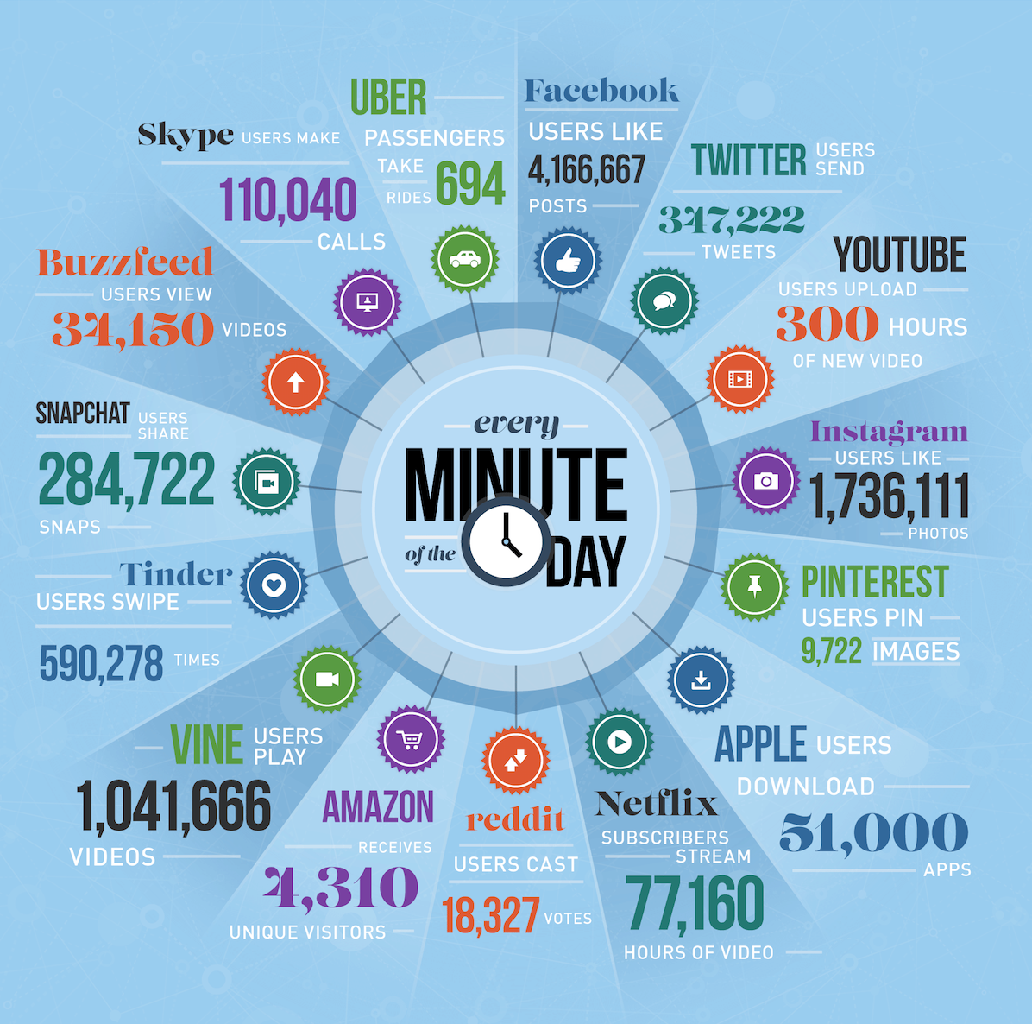

Slide 13
Social Media Analytics - Process
1. Collecting data
2. Understanding themes and patterns
3. Presenting findings

Slide 14
Social Media Analytics - Purposes
1. Describing current trends and patterns
2. Prescribing courses of action
3. Predicting future outcomes
Techniques:
Text mining
Content analysis
Metadata analysis
Social network analysis
Cartographic mapping

Slide 15
Part Three
Analytics in the Classroom

Slide 16
Personal Twitter Analytics
http://analytics.twitter.com

Slide 17
Personal Twitter Analytics - Competencies
Practical
Finding and running analytics in Twitter
Exporting content
Cognitive
Differences between metrics
Ability to compare trends over time
Ability to assess and make recommendations
Critical assessment of why Twitter provides analytics
Affective
Build confidence in tweeting
Recognize apprehensions or biases about the platform

Slide 18
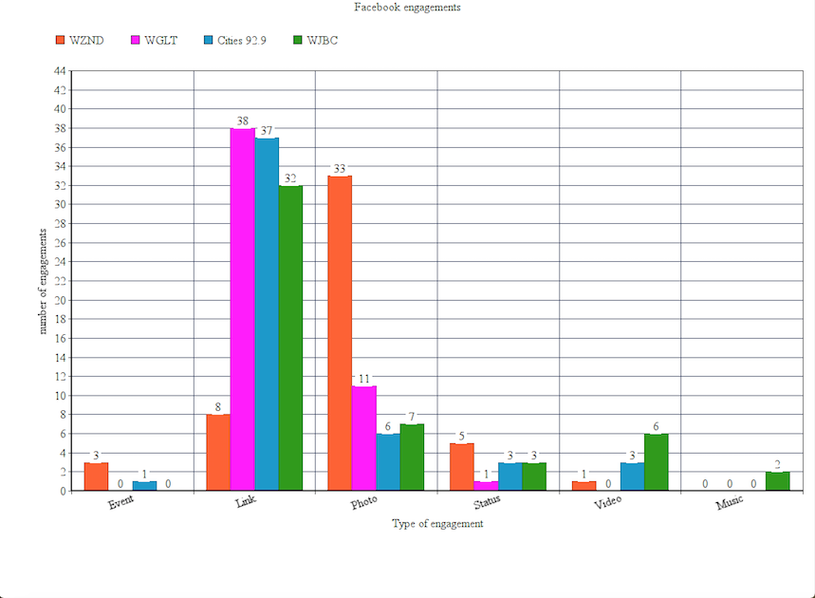
Facebook Page Comparison
https://apps.facebook.com/netvizz/

Slide 19
Facebook Page Comparison - Competencies
Practical
Exporting data from Facebook
Using Microsoft Excel to make charts and graphs
Cognitive
Selecting relevant points of comparison
Identify trends over time
Identify differences in organizational goals and strategies
Recognize privacy issues and potential surveillance
Affective
Build confidence in working with raw data
Recognize effective posting strategies

Slide 20
Social Network Analysis

Slide 21
Social Network Analysis - Competencies
Practical
How to collect data
How to graph relationships among users
Cognitive
Assessing how we measure influence
Examining how social media leverage power structures
Recognizing how social media platforms might contribute to polarization
Affective
“Wow” factor that energizes students, participants
Builds confidence in using mathematical theory and application

Slide 22
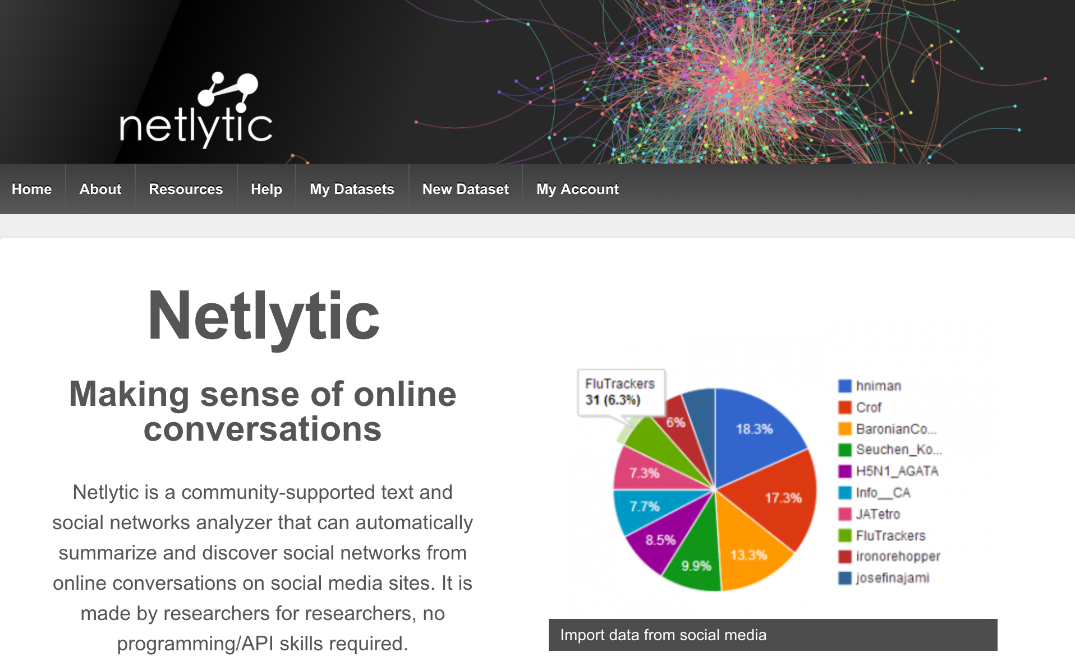
Get Started with Netlytic
https://netlytic.org

Slide 23
Consult with the SMACC

